Slide 1
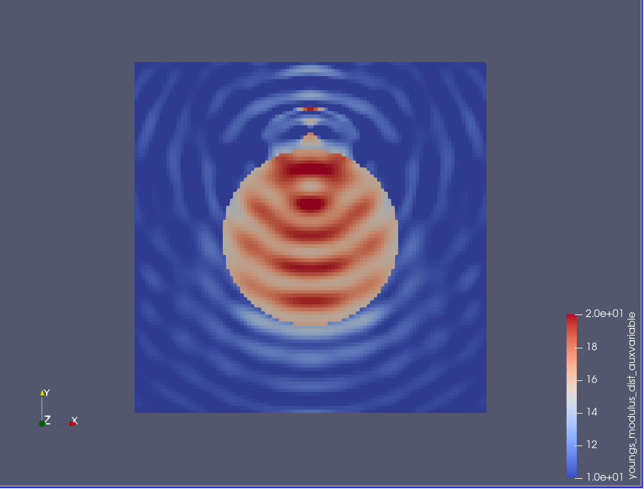
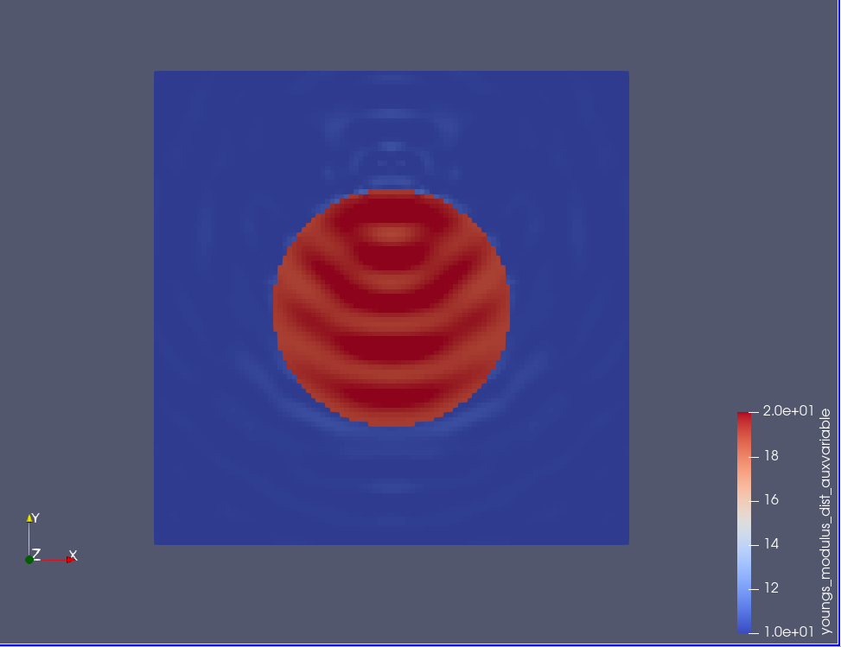
Input data
Compressible elastic wave equation
Ex.1-top
1 source @ (0.5,0.8)
Receivers: entire wavefield is considered.
1 freq @ (w=100 cycle)
E_matrix=10
E_inclusion=20
Initial_guess_inclusion=15
Diameter=0.5
Domain= 1x1
Mesh =100x100
Ex.1-bottom
Same input except Initial_guess_inclusion=19

Slide 2
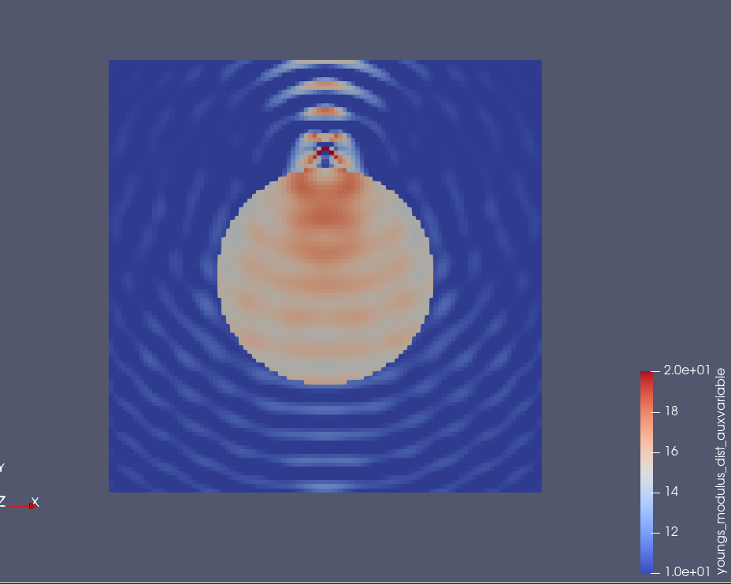
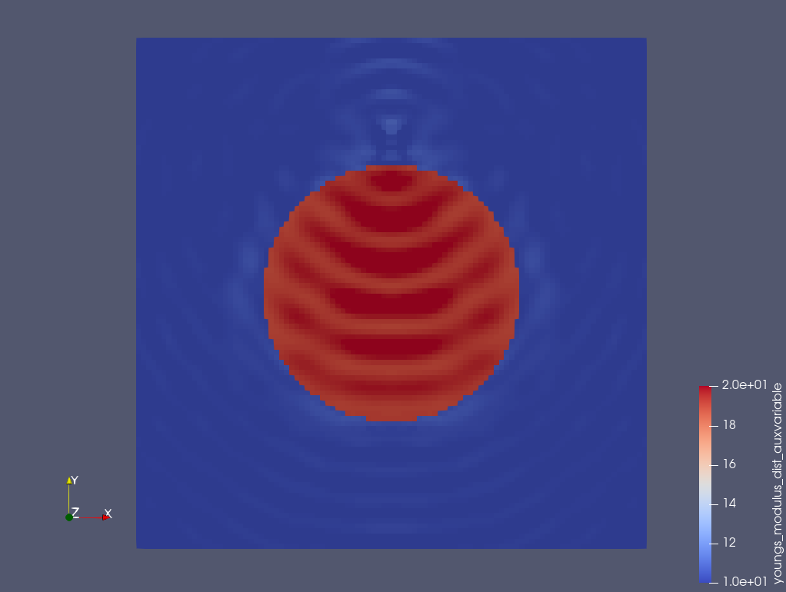
Parameters takes negative/very small values in the inversion process.
Input data
Incompressible elastic wave equation
Ex.1-top
1 source @ (0.5,0.8)
Receivers: entire wavefield is considered.
1 freq @ (w=100 cycle)
E_matrix=10
E_inclusion=20
Initial_guess_inclusion=15
Diameter=0.5
Domain= 1x1
Mesh =100x100
Ex.1-bottom
Same input except Initial_guess_inclusion=19

Slide 3
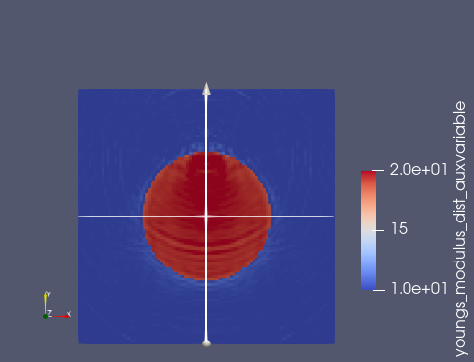
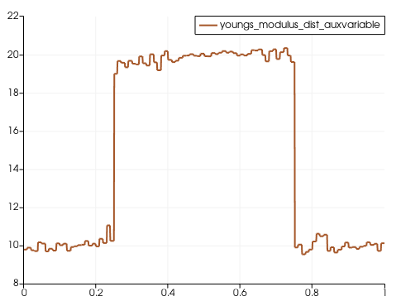
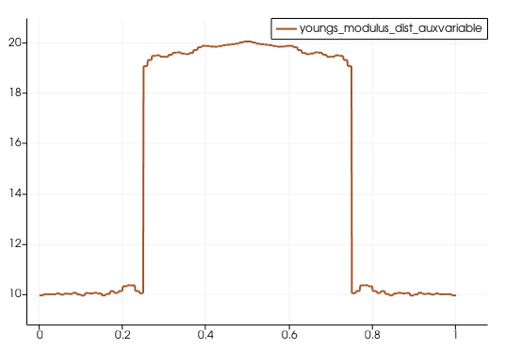
Input data
Incompressible elastic wave equation
1 source @ (0.5,0.8)
Receivers: entire wavefield is considered.
11 freq @ (w=100-300@20 cycle)
E_matrix=10
E_inclusion=20
Initial_guess_inclusion=19
Diameter=0.5
Domain= 1x1
Mesh =100x100
Section 1
Section 2
L2 norm – misfit function is used
Section 2
Section 1

Slide 4
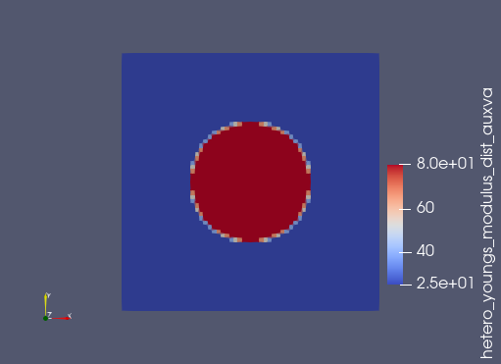
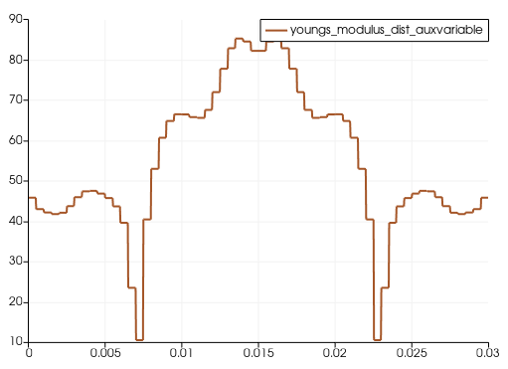
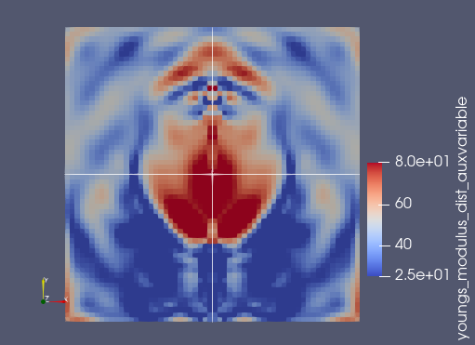
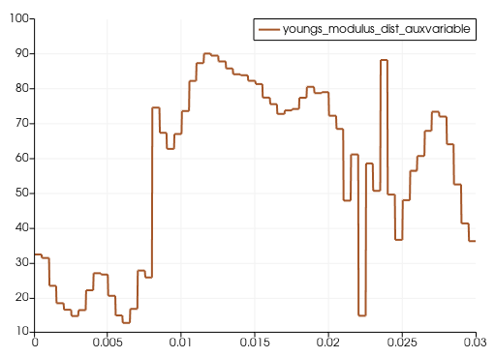
Input data
Incompressible elastic wave equation
1 source @ (0.015,0.024)
Receivers: 44 RCV@0.005.
51 freq @ (w=100-600@10 Hz)
E_matrix=25 kpa
E_inclusion=80 kpa
Initial_guess – was mistakenly set as homogenous=50 kpa
Diameter=0.014=14 mm
Domain= 0.03x0.03= 30 mmx30 mm
Mesh =60x60
Section 2
Section 1
Section 1
Cross-correlation function is used
Section 2

Slide 5
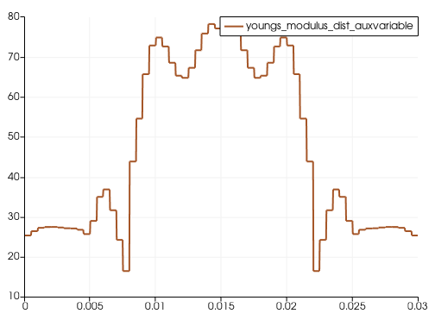
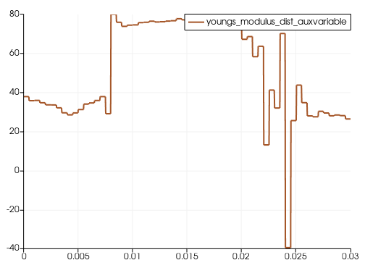
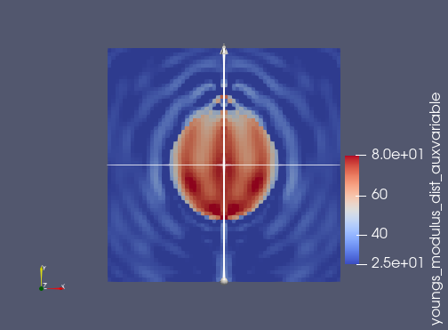
Input data
Incompressible elastic wave equation
1 source @ (0.015,0.024)
Receivers: 44 RCV@0.005.
51 freq @ (w=100-600@10 HZ)
E_matrix=25 kpa
E_inclusion=80 kpa
Initial_guess inclusion=50 kpa
Diameter=0.014=14 mm
Domain= 0.03x0.03= 30 mmx30 mm
Mesh =60x60
Section 2
Section 1
Cross-correlation function is used

Slide 6
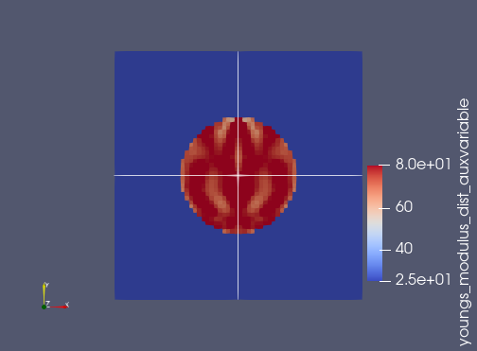
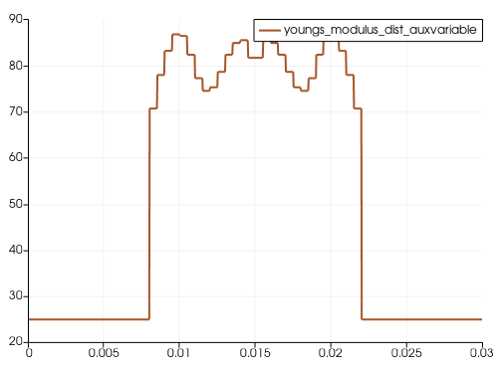
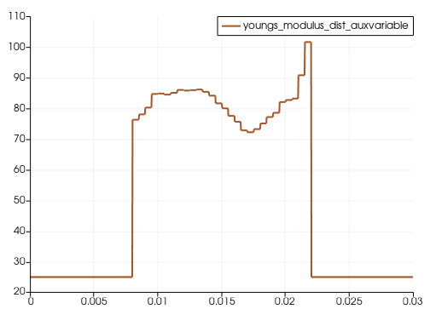
Input data
Incompressible elastic wave equation
1 source @ (0.015,0.024)
Receivers: 44 RCV@0.005.
11 freq @ (w=100-600@50 HZ)
E_matrix=25 kpa
E_inclusion=80 kpa
Initial_guess inclusion=50 kpa
Diameter=0.014=14 mm
Domain= 0.03x0.03= 30 mmx30 mm
Mesh =60x60
Section 2
Section 1
Section 1
Cross-correlation function is used
Section 2

Slide 7
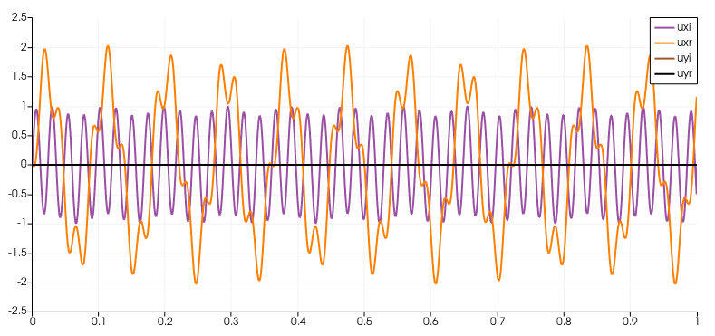
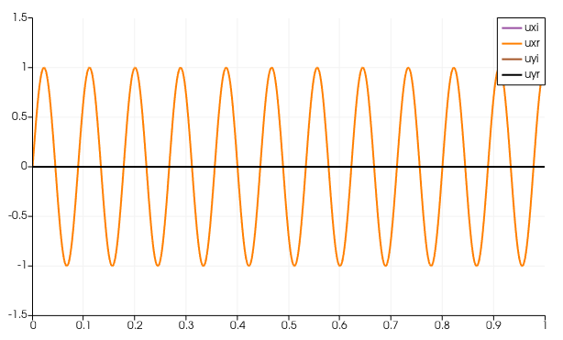
W=100 cycle,
Rho=1

Slide 8
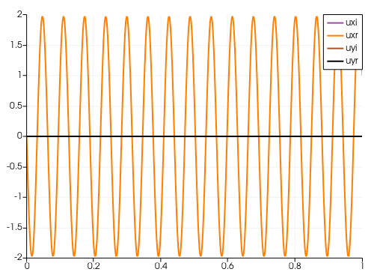
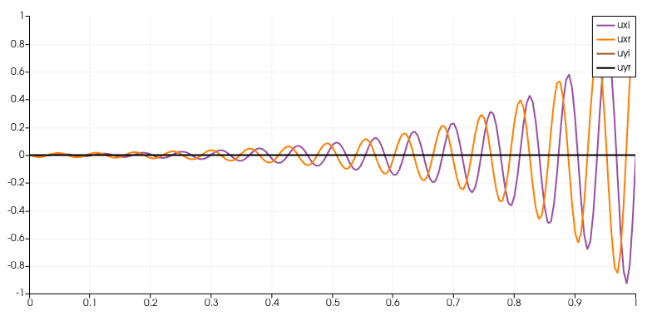

Slide 9
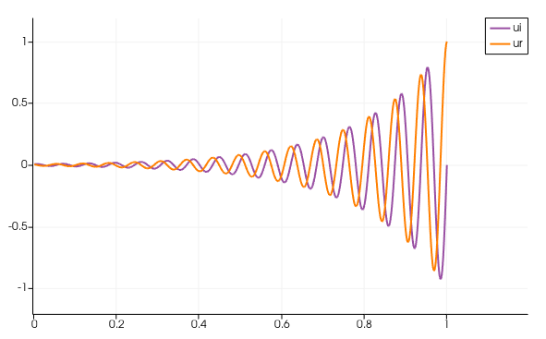

Slide 10
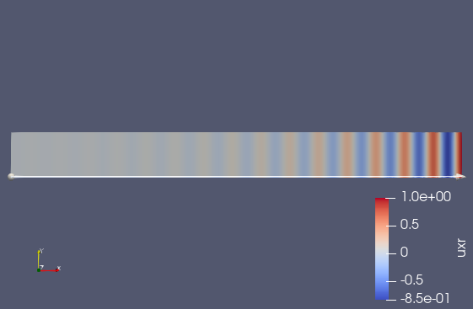
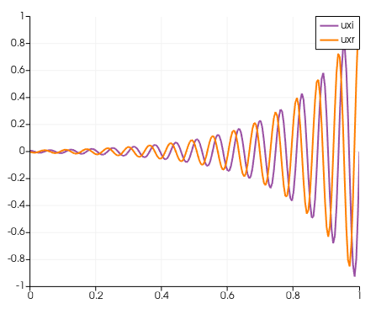

Slide 11
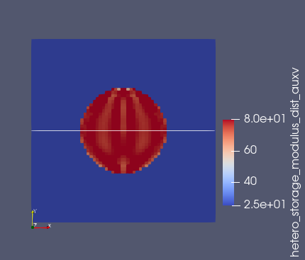
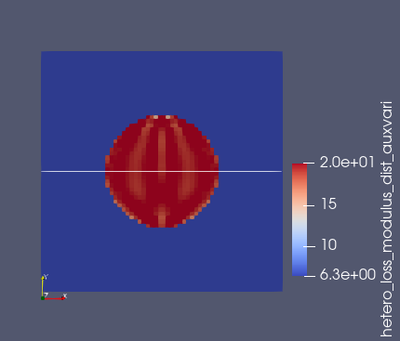
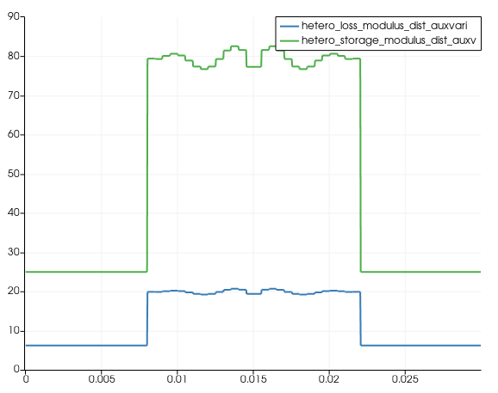
Incompressibe viscoelastic wave equation inversion
Input data
1 source @ (0.015,0.024)
Receivers: 44 RCV@0.005.
11 freq @ (w=100-600@50 HZ)
E_matrix=25 (1+i*w/w_bar) kpa
E_inclusion=80 (1+i*w/w_bar) kpa , w_bar=15000
Initial_guess inclusion=50 (1+i*w/w_bar) kpa
Diameter=0.014=14 mm
Domain= 0.03x0.03= 30 mmx30 mm
Mesh =60x60
Only one component of the wavefield is considered (Ux)
Reconstructed storage modulus
Reconstructed loss modulus @600HZ
Horizontal section cut - Elastic and viscoelastic modulus at @ 600 HZ
Convergence behavior-CC functional

Slide 12
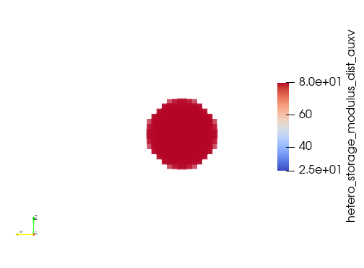
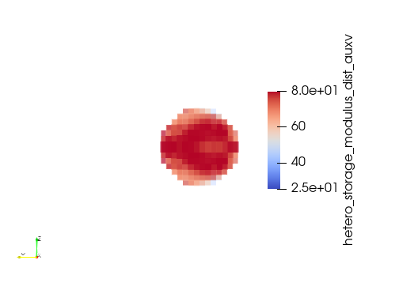
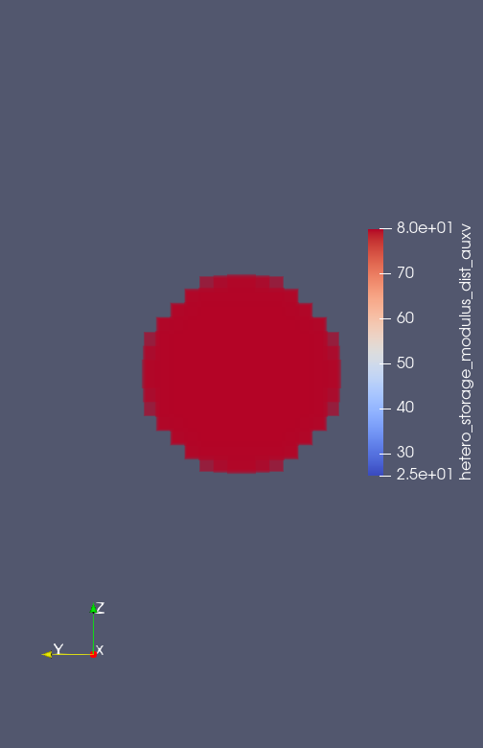
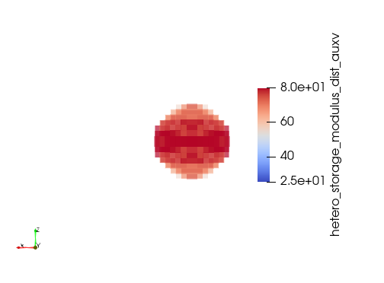
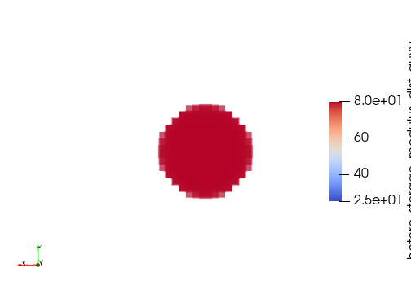
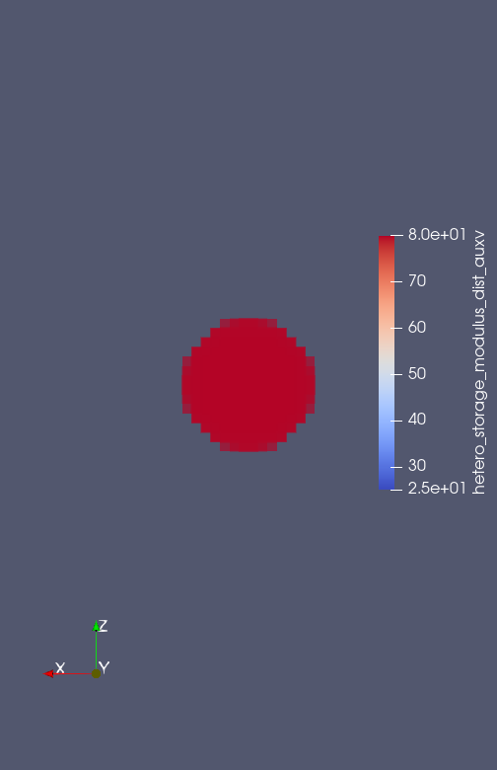
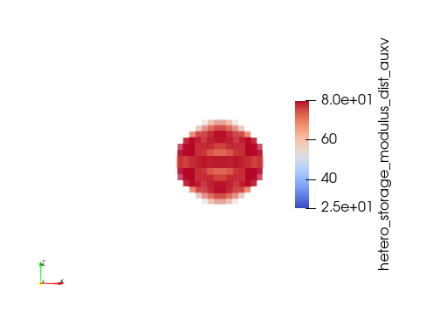

3D Incompressibe viscoelastic wave equation inversion
Input data
1 source @ (0.015,0.024,0.015)
Receivers: 713 RCV (sampled on vertical plane where
top_right_point = '0.03 0.022 0.015'
bottom_left_point = '0.0 0.0 0.015‘)
9 freq @ (w=100-500@50 HZ)
E_matrix=25 (1+i*w/w_bar) kpa
E_inclusion=80 (1+i*w/w_bar) kpa , w_bar=15000
Initial_guess inclusion=50 (1+i*w/w_bar) kpa
Diameter=0.014=14 mm
Domain= 0.03x0.03= 30 mmx30 mm
Mesh =30x30x30
Only one component of the wavefield is considered (Ux)
Storage modulus reconstruction

Slide 13
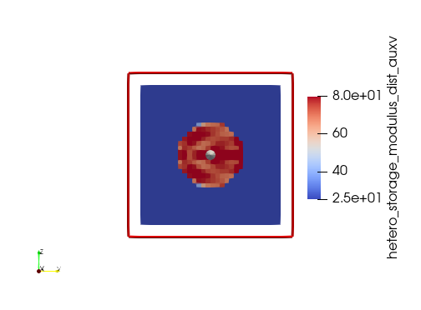
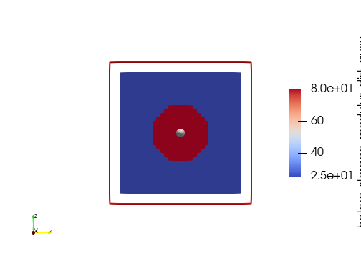
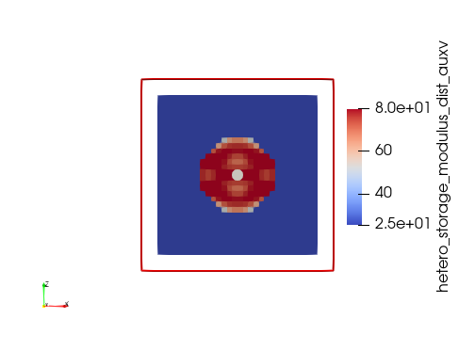
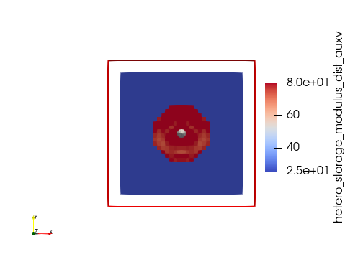
All origin is at the center
Unit normal in x direction
Unit normal in y direction
Unit normal in z direction
Storage modulus reconstruction

Slide 14
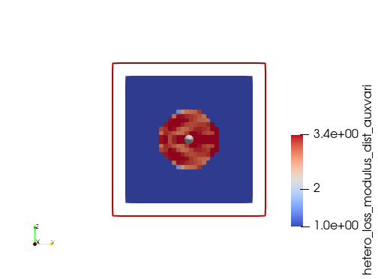
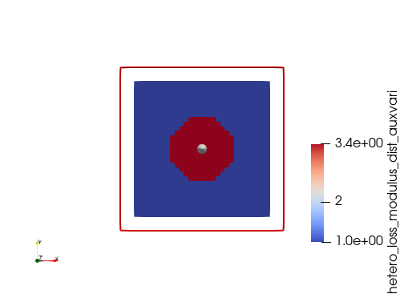
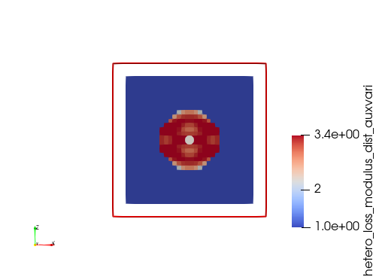
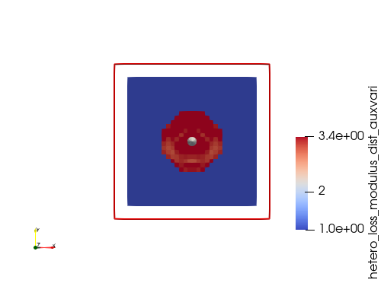
Unit normal in x direction
Unit normal in y direction
Unit normal in z direction
Loss modulus reconstruction @100Hz

Slide 15
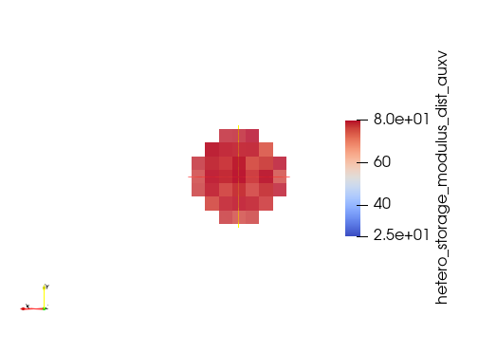
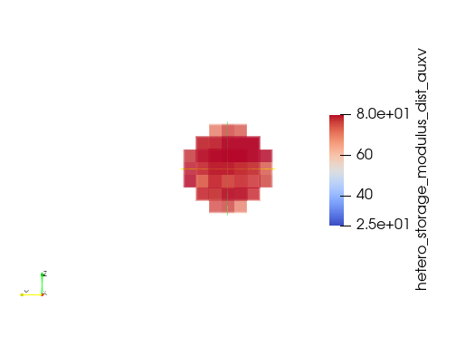
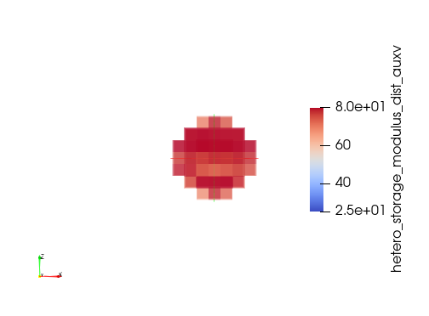
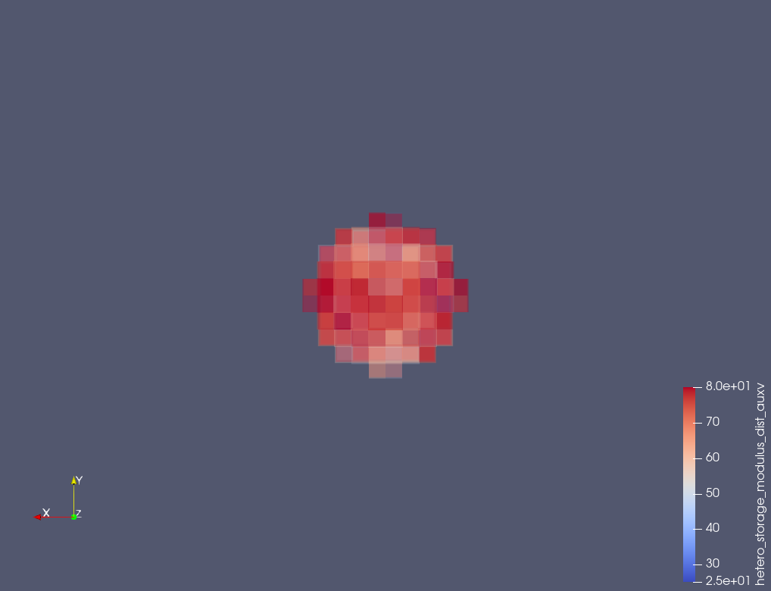
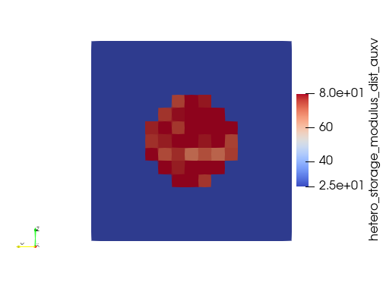
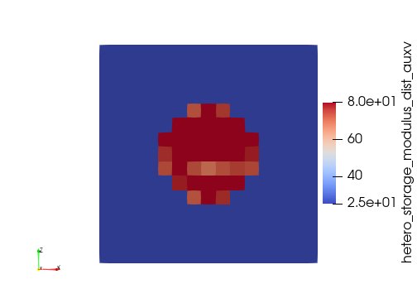
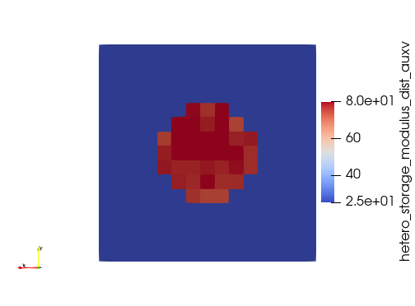
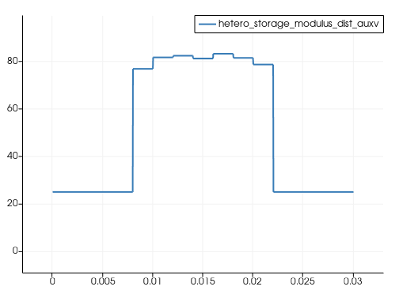
3D Incompressibe viscoelastic wave equation inversion
Input data
Domain= 0.03x0.03= 30 mmx30 mm
Mesh =15x15x15
1 source @ (0.014 0.024 0.014)
Receivers: 176 RCV (sampled on vertical plane where
top_right_point = '0.03 0.02 0.016'
bottom_left_point = '0.0 0.0 0.016‘)
5 freq @ (freq=100-300@50 HZ)
E_matrix=25 (1+i*w/w_bar) kpa
E_inclusion=80 (1+i*w/w_bar) kpa , w_bar=15000
Initial_guess inclusion=50 (1+i*w/w_bar) kpa
Only one component of the wavefield is considered (Ux)
Sampling line:
point1= '0.0 0.015 0.0115'
point2 = '0.3 0.15 0.015‘)

Slide 16







3D Incompressibe viscoelastic wave equation inversion
Input data
Noise : AWGN= 30dB
Domain= 0.03x0.03= 30 mmx30 mm
Mesh =15x15x15
1 source @ (0.014 0.024 0.014)
Receivers: 176 RCV (sampled on vertical plane where
top_right_point = '0.03 0.02 0.016'
bottom_left_point = '0.0 0.0 0.016‘)
5 freq @ (freq=100-300@50 HZ)
E_matrix=25 (1+i*w/w_bar) kpa
E_inclusion=80 (1+i*w/w_bar) kpa , w_bar=15000
Initial_guess inclusion=50 (1+i*w/w_bar) kpa
Only one component of the wavefield is considered (Ux)
Sampling line:
point1= '0.0 0.015 0.0115'
point2 = '0.3 0.15 0.015‘)

Slide 17







3D Incompressibe viscoelastic wave equation inversion
Input data
Noise : AWGN= 20dB
Domain= 0.03x0.03= 30 mmx30 mm
Mesh =15x15x15
1 source @ (0.014 0.024 0.014)
Receivers: 176 RCV (sampled on vertical plane where
top_right_point = '0.03 0.02 0.016'
bottom_left_point = '0.0 0.0 0.016‘)
5 freq @ (freq=100-300@50 HZ)
E_matrix=25 (1+i*w/w_bar) kpa
E_inclusion=80 (1+i*w/w_bar) kpa , w_bar=15000
Initial_guess inclusion=50 (1+i*w/w_bar) kpa
Only one component of the wavefield is considered (Ux)
Sampling line:
point1= '0.0 0.015 0.0115'
point2 = '0.3 0.15 0.015‘)

Slide 18







3D Incompressibe viscoelastic wave equation inversion
Input data
Noise : AWGN= 10dB
Domain= 0.03x0.03= 30 mmx30 mm
Mesh =15x15x15
1 source @ (0.014 0.024 0.014)
Receivers: 176 RCV (sampled on vertical plane where
top_right_point = '0.03 0.02 0.016'
bottom_left_point = '0.0 0.0 0.016‘)
5 freq @ (freq=100-300@50 HZ)
E_matrix=25 (1+i*w/w_bar) kpa
E_inclusion=80 (1+i*w/w_bar) kpa , w_bar=15000
Initial_guess inclusion=50 (1+i*w/w_bar) kpa
Only one component of the wavefield is considered (Ux)
Sampling line:
point1= '0.0 0.015 0.0115'
point2 = '0.3 0.15 0.015‘)

Slide 19







3D Incompressibe viscoelastic wave equation inversion
Input data
Noise : AWGN= 10dB
Domain= 0.03x0.03= 30 mmx30 mm
Mesh =15x15x15
1 source @ (0.014 0.024 0.014)
Receivers: 176 RCV (sampled on vertical plane where
top_right_point = '0.03 0.02 0.016'
bottom_left_point = '0.0 0.0 0.016‘)
11 freq @ (freq=100-300@20 HZ)
E_matrix=25 (1+i*w/w_bar) kpa
E_inclusion=80 (1+i*w/w_bar) kpa , w_bar=15000
Initial_guess inclusion=50 (1+i*w/w_bar) kpa
Only one component of the wavefield is considered (Ux)
Sampling line:
point1= '0.0 0.015 0.0115'
point2 = '0.3 0.15 0.015‘)

Slide 20







3D Incompressibe viscoelastic wave equation inversion
Input data
Noise : AWGN= 10dB
Domain= 0.03x0.03= 30 mmx30 mm
Mesh =20x20x20
1 source @ (0.015 0.024 0.015)
Receivers: 315 RCV (sampled on vertical plane where
top_right_point = '0.03 0.021 0.0165'
bottom_left_point = '0.0 0.0 0.0165’)
10 freq @ (freq=100-480@40 HZ)
E_matrix=25 (1+i*w/w_bar) kpa
E_inclusion=80 (1+i*w/w_bar) kpa , w_bar=15000
Initial_guess inclusion=50 (1+i*w/w_bar) kpa
Only one component of the wavefield is considered (Ux)
Sampling line:
point1= '0.0 0.015 0.0115'
point2 = '0.3 0.15 0.015‘)

Slide 21


2D Incompressibe viscoelastic wave equation inversion
Input data
Domain= 0.03x0.03= 30 mmx30 mm
Mesh =60x60
1 source @ (0.015 0.024)
Receivers: 40 RCV (sampled on vertical a line @ x=15mm
16 freq @ (freq=100-475@25 HZ)
E_matrix=25 +i*25*w/w_bar) kpa
E_inclusion=80+i*80*w/w_bar) kpa ,
w_bar=15000
Initial_guess inclusion=30+i*30*w/w_bar) kpa
Only one component of the wavefield is considered (Ux)
Parameterization: G= G_r +iG_i *w/w_bar
Both G_r and G_i are the parameters to be inverted.

Slide 22


[kpa]

Slide 23



Slide 24

Urban PWE (2021)
Shear moduli: (8.33,26.66) kPa for background and inclusion
Inclusion diameter: (4.05,6.49,10.4)mm – cylindrical
ROI: 16x16 mm2
They also used 20 mm diameter – spherical with ROI 30x30
Fmin-Fmax: 500-1500Hz
Cloutier (2017)
Viscosity (0.4-1.14) Pa.s for background and inclusion

Slide 25


Cloutier (2014)
Viscosity: (0.1-1.5) Pa.s for background and inclusion
Shea elasticity: (5-20) kPa for background and inclusion

Slide 26

Fink (2005) – values measured by MRI

Slide 27


Slide 28





Slide 29



2D Incompressibe viscoelastic wave equation inversion
Input data
Domain= 0.03x0.03= 30 mmx30 mm
Mesh =60x60
Push @ (0.015 0.024)
Receivers: 40 RCV (sampled on vertical a line @ x=15mm
16 freq @ (freq=100-475@25 HZ)
Viscoelastic model: Kelvin-Voigt
$E$= $15+9∗sin⁡(70∗pi∗((0.03−x)^2/0.03))∗sin⁡(80∗pi∗(y))$ kPa
$η=3$ Pa.s (known)
Invert only for $E$
Initial guess $E$= $15$kPa
Only one component of the wavefield is considered (Ux)

Slide 30


2D Incompressibe viscoelastic wave equation inversion
Input data
Domain= 0.03x0.03= 30 mmx30 mm
Mesh =60x60
Push @ (0.015 0.024)
Receivers: 40 RCV (sampled on vertical a line @ x=15mm
16 freq @ (freq=100-475@25 HZ)
Viscoelastic model: Kelvin-Voigt
$E$= $15+9∗sin⁡(70∗pi∗((0.03−x)^2/0.03))∗sin⁡(80∗pi∗(y))$ kPa
$$η=7.5+4.5∗sin⁡(70∗pi∗((0.03−y)^2/0.03+x))∗sin⁡(80∗pi∗((0.03−x)^2/0.03+y)) (known)$$
Invert only for $E$
Initial guess $E$= $15$kPa
Only one component of the wavefield is considered (Ux)

Slide 31


2D Incompressibe viscoelastic wave equation inversion
Input data
Domain= 0.03x0.03= 30 mmx30 mm
Mesh =60x60
Push @ (0.015 0.024)
Receivers: 61 RCV (sampled on vertical a line @ x=15mm
16 freq @ (freq=100-475@25 HZ)
Viscoelastic model: Kelvin-Voigt
$E$= $15+9∗sin⁡(70∗pi∗((0.03−x)^2/0.03))∗sin⁡(80∗pi∗(y))$ kPa
$$η(true)=7.5+4.5∗sin\left(70∗pi∗\left(\frac{{\left(0.03−y\right)}^{2}}{0}.03+x\right)\right)∗sin\left(80∗pi∗\left(\frac{{\left(0.03−x\right)}^{2}}{0}.03+y\right)\right)$$
$η(forward)=7.5$ (known)
Invert only for $E$
Initial guess $E$= $15$kPa
Only one component of the wavefield is considered (Ux)
Notice that the image is symmetric around the rcv line whereas it is not in the ground truth. This may be a result of assuming homogenous young’s modulus as initial guess, and known homogenous viscosity.
Also notice the large error in region surrounds the push. This is always happening!

Slide 32


2D Incompressibe viscoelastic wave equation inversion
Input data
Domain= 0.03x0.03= 30 mmx30 mm
Mesh =60x60
Push @ (0.015 0.024)
Receivers: 44 RCV (sampled on vertical a line @ x=15mm
12 freq @ (freq=125-400@25 HZ)
Viscoelastic model: Kelvin-Voigt
$E$= $15+9∗sin⁡(70∗pi∗((0.03−x)^2/0.03))∗sin⁡(80∗pi∗(y))$ kPa
$$η(true)=7.5+4.5∗sin\left(70∗pi∗\left(\frac{{\left(0.03−y\right)}^{2}}{0}.03+x\right)\right)∗sin\left(80∗pi∗\left(\frac{{\left(0.03−x\right)}^{2}}{0}.03+y\right)\right)$$
$η(forward)=7.5$ (known)
Invert only for $E$
Initial guess $E$= $15$kPa
Only one component of the wavefield is considered (Ux)

Slide 33


2D Incompressibe viscoelastic wave equation inversion
Input data
Domain= 0.03x0.03= 30 mmx30 mm
Mesh =60x60
Push @ (0.015 0.024)
Receivers: 40 RCV (sampled on vertical a line @ x=15mm
14 freq @ (freq=125-450@25 HZ)
Viscoelastic model: Kelvin-Voigt
$E$= $15+9∗sin⁡(70∗pi∗((0.03−x)^2/0.03))∗sin⁡(80∗pi∗(y))$ kPa
$$η(true)=7.5+4.5∗sin\left(70∗pi∗\left(\frac{{\left(0.03−y\right)}^{2}}{0}.03+x\right)\right)∗sin\left(80∗pi∗\left(\frac{{\left(0.03−x\right)}^{2}}{0}.03+y\right)\right)$$
$η\left(forward\right)=η\left(true\right)$(known)
Invert only for $log(E)$
Initial guess $E$= $15$kPa
Only one component of the wavefield is considered (Ux)

Slide 34


2D Incompressibe viscoelastic wave equation inversion
Input data
Domain= 0.03x0.03= 30 mmx30 mm
Mesh =60x60
Push @ (0.015 0.024)
Receivers: 40 RCV (sampled on vertical a line @ x=15mm
16 freq @ (freq=100-475@25 HZ)
Viscoelastic model: Kelvin-Voigt
$E$= $15+9∗sin⁡(70∗pi∗((0.03−x)^2/0.03))∗sin⁡(80∗pi∗(y))$ kPa
$$η(true)=7.5+4.5∗sin\left(70∗pi∗\left(\frac{{\left(0.03−y\right)}^{2}}{0}.03+x\right)\right)∗sin\left(80∗pi∗\left(\frac{{\left(0.03−x\right)}^{2}}{0}.03+y\right)\right)$$
$η(forward)=7.5$ (known)
Invert only for $log(E)$
Initial guess $E$= $15$kPa
Only one component of the wavefield is considered (Ux)

Slide 35


Group1
Acquisition in middle and freq=[100-475 @ 25Hz]
Group2
Acquisition @ x=8 mm, and freq=[100-200 @10HZ]
After 5 iter
After 50 iter
Does wrong viscosity confuse the inversion? Try use true viscosity

Slide 36








Simultaneous inversion of 2 acquisition2
2D Incompressibe viscoelastic wave equation inversion
Input data
Domain= 0.03x0.03= 30 mmx30 mm
Mesh =60x60
Push @ (0.015 0.024)
Receivers: 40 RCV (sampled on vertical a line @ x=15mm
14 freq @ (freq=125-450@25 HZ)
Viscoelastic model: Kelvin-Voigt
$E$= $15+9∗sin⁡(70∗pi∗((0.03−x)^2/0.03))∗sin⁡(80∗pi∗(y))$ kPa
$$η(true)=7.5+4.5∗sin\left(70∗pi∗\left(\frac{{\left(0.03−y\right)}^{2}}{0}.03+x\right)\right)∗sin\left(80∗pi∗\left(\frac{{\left(0.03−x\right)}^{2}}{0}.03+y\right)\right)$$
$η\left(forward\right)=η\left(true\right)$(known)
Invert only for $log(E)$
Initial guess $E$= $15$kPa
Only one component of the wavefield is considered (Ux)

Slide 37






For 125-300 with 25 increment
For 300-450 with 25 increment
For 125-300 with 25 increment

Slide 38




For 125-200 with 25 increment
Initial E=10 kPa, initial eta=6 Pa.s

Slide 39


Elasticity in (12-18) kPa
Viscosity =3 Pa.s (uniform)
Inverting for elasticity and viscosity simultaneously
Initial E=15 kPa, initial eta=2 Pa.s
Note:
This example shows that although we have diffused elasticity modulus, we still somewhat getting some sense of the ground truth (for both the viscosity and elasticity). However, I think regularization should be considered, or different reconstruction strategy.

Slide 40




Starting from homogenous elasticity and viscosity
Ground truth
Reconstructed

Slide 41




Starting from homogenous elasticity and viscosity
Note:
This example is important because one of the question I was asked in the ASA conference (what is the smallest size/resolution of tumor that this method can reconstruct ?).
This shows that, even with one acquisition, no prior information about the tumor shape, this still can reconstructs elasticity, viscosity simultaneously. This could be a good method for early detection of tumors.

Slide 42



Slide 43






Single acquisition in middle
Frequency: (50-650) Hz with increment of 100 Hz (7 freqs)
Inverting for viscosity only
Initial homogenous viscosity =1 Pa.s
Note that, E here is the exact true E
Single acquisition in middle
Frequency: (50-650) Hz with increment of 100 Hz (7 freqs)
Inverting for viscosity and E
Initial homogenous E=15 kpa, viscosity =1 Pa.s
Single acquisition in middle
Frequency: (50-650) Hz with increment of 100 Hz (7 freqs)
Inverting for viscosity only
Use the reconstructed E and eta, then invert only for eta.
Note that, here E is the reconstruceted. This means, we have to reconstruct E first as accurate as possible so that we can invert for the viscosity. This may be changed based on the values of E, eta

Slide 44



Similar example to the previous one except eta (3 and 9) Pa.s
Single acquisition in middle
Frequency: (50-650) Hz with increment of 100 Hz (7 freqs)
Inverting for viscosity and E
Initial homogenous E=15 kpa, viscosity =3 Pa.s
Single acquisition in middle
Frequency: (50-650) Hz with increment of 100 Hz (7 freqs)
Inverting for viscosity only
Use the reconstructed E and eta, then invert only for eta.
Note that, here E is the reconstructed. This means, we have to reconstruct E first as accurate as possible so that we can invert for the viscosity. This may be changed based on the values of E, eta

Slide 45




Similar example to the previous one except eta (3 and 9) Pa.s
Single acquisition in middle
Frequency: (50-650) Hz with increment of 100 Hz (7 freqs)
Inverting for viscosity and E (for inclusion only)
Initial inclusion E=30 kPa, viscosity =6 Pa.s -> this is much better initial guess than what we have been using before (homogenous)
True
Initial
E (Pa)
Lateral distance (m)
True
Viscosity (Pa.s)
Initial
Lateral distance (m)

Slide 46




Similar example to the previous one except eta (3 and 9) Pa.s
Single acquisition in middle
Frequency: (50-650) Hz with increment of 100 Hz (7 freqs)
Inverting for viscosity and E (for inclusion only)
Initial inclusion homogenous E=15 kPa, viscosity =3 Pa.s
True
E (Pa)
Lateral distance (m)
True
Viscosity (Pa.s)
Lateral distance (m)

Slide 47




Similar example to the previous one except eta (3 and 9) Pa.s
Single acquisition in middle
Frequency: (50-650) Hz with increment of 100 Hz (7 freqs)
Inverting for viscosity and E (for inclusion only)
Used the average of the previous results as initial estimate
E (Pa)
Lateral distance (m)
Viscosity (Pa.s)
Lateral distance (m)

Slide 48




Similar example to the previous one except eta (3 and 9) Pa.s
Single acquisition in middle
Frequency: (50-650) Hz with increment of 100 Hz (7 freqs)
Inverting for viscosity and E (for inclusion only)
Used E=10kpPa, eta=2 Pa.s as initial estimate
E (Pa)
Lateral distance (m)
Viscosity (Pa.s)
Lateral distance (m)

Slide 49




Similar example to the previous one except eta (3 and 9) Pa.s
Single acquisition in middle
Frequency: (50-650) Hz with increment of 100 Hz (7 freqs)
Inverting for viscosity and E (for inclusion only)
Used E=15kpPa, eta=2 Pa.s as initial estimate
E (Pa)
Lateral distance (m)
Viscosity (Pa.s)
Lateral distance (m)

Slide 50




Similar example to the previous one except eta (3 and 9) Pa.s
Single acquisition in middle
Frequency: (50-650) Hz with increment of 100 Hz (7 freqs)
Inverting for viscosity and E (for all ROI)
Used E=15kpPa, eta=2 Pa.s (30% wrong viscosity in the background and about 77% wrong at the inclusion) as initial estimate
E (Pa)
We use this results, get the average of the elasticity and viscosity of the background and inclusion (we can estimate the size of the inclusion from the images), then use the average values as initial estimate for another inversion (either restrict inversion to inclusion or invert for the entire ROI).
Lateral distance (m)
Viscosity (Pa.s)
Update: when used the average of these results for the background and inclusion, and restricted the inversion to the inclusion, the elasticity and viscosity values blow up in the center and on the edges to very-wrong values.
Lateral distance (m)

Slide 51








Adding low frequency content to the previous results. Here we used the previous results as initial estimate to inversion over (10-100) with increment 10 HZ (Notice there is overlap at two frequencies 50 and 100 HZ).
Idea: How would the average of E and eta of inclusion and background compare to the TOF (point-wise imaging, local-based imaging)?!
If there are some agreement, this would give some insight.
E (Pa)
Lateral distance (m)
Taking mean
Viscosity (Pa.s)
See the results next slide
Lateral distance (m)

Slide 52








Used the previous results, averaging them inside and outside the inclusion. And invert over 50-650 with 100Hz increment (7 freqs)
Note that, here we fix the viscosity as shown.
We still getting some good images (at least in terms of the average).
So, one possible inversion steps:
1- invert for the whole ROI, using approx. eta and E. Give the freedom to the algorithm to update the eta and E to the nearest solution to the true solution.
2- invert only for E, fix eta
3- invert only for eta, fix E
E (Pa)
Lateral distance (m)
Viscosity (Pa.s)
Lateral distance (m)
Viscosity (Pa.s)
E (Pa)
Lateral distance (m)
Lateral distance (m)

Slide 53








Frequency: (100-1000) Hz with increment of 100 Hz (11 freqs)
Inverting for viscosity and E (for inclusion only)
Initial inclusion homogenous E=15 kPa, viscosity =3 Pa.s
On the left, all frequencies at once, on right using multiscale (100-300), (300-600), (600-1000)

Slide 54








Frequency: (50-600) Hz with increment of 50 Hz (12 freqs)
Inverting for viscosity and E (for inclusion only)
Initial inclusion homogenous E=15 kPa, viscosity =3 Pa.s
On the left, all frequencies at once (30 iters), on right using multiscale (50-200), (250-400), (450-600), 10 iters each
All freqs
Progressive-no overlap

Slide 55




Inverting for viscosity and E (for inclusion only)
Initial inclusion homogenous E=15 kPa, viscosity =3 Pa.s
(50-200), (50-400), (50-600)
Progressive - with overlap

Slide 56








Frequency: (50-650) Hz with increment of 100Hz (7 freqs)
Inverting for viscosity and E (for inclusion only)
Initial inclusion homogenous E=15 kPa, viscosity =3 Pa.s
On the left, all frequencies at once (40 iters), on right using multiscale (two scales) (50-350) & (350-650) (20 iters each)
All freqs
Progressive-no overlap

Slide 57




Frequency: (50-650) Hz with increment of 100Hz (7 freqs)
Inverting for viscosity and E (for inclusion only)
Initial inclusion homogenous E=15 kPa, viscosity =3 Pa.s
multiscale (two scales) (50-350) & (50-650) (20 iters each)
Progressive-with overlap
This week
1-Multi-resolution inversion but with one parameter at a time (E then eta)
2-Inversion of heterogeneous inclusion

Slide 58








Frequency: (50-650) Hz with increment of 100Hz (7 freqs)
Inverting for viscosity and E (for inclusion only)
Initial inclusion homogenous E=15 kPa, viscosity =3 Pa.s
multiscale (two scales) (50-350) & (50-650) (20 iters each)
The difference here, we used the average of E, eta resulted from group1(50-350) as initial guess to regularize the inversion for the second group (50-650) HZ
Average of the results of (50-350) HZ and use it as starting point for (50-650) HZ
Much better results

Slide 59




Frequency: (50-650) Hz with increment of 100Hz (7 freqs)
Inverting for viscosity and E (for inclusion only)
Initial inclusion homogenous E=15 kPa, viscosity =3 Pa.s
multiscale (two scales) (50-350) & (350-650) (20 iters each)
The difference here, we used the average of E, eta resulted from group1(50-350) as initial guess to regularize the inversion for the second group (350-650) HZ
Average of the results of (50-350) HZ and use it as starting point for (350-650) HZ

Slide 60




Frequency: (50-650) Hz with increment of 100Hz (7 freqs)
Inverting for E (for inclusion only), fix viscosity
Initial inclusion homogenous E = the resulted inversion from the previous slide (simultaneous inversion of E and eta)
multiscale (two scales) (50-350) & (350-650) (20 iters each)
Then, use the same technique to reconstruct viscosity
Averaging viscosity

Slide 61


Frequency: (50-650) Hz with increment of 100Hz (7 freqs)
Inverting for E (for inclusion only), fix viscosity
Initial inclusion homogenous E = the resulted inversion from the previous slide (simultaneous inversion of E and eta)
multiscale (two scales) (50-350) & (350-650) (20 iters each)
No viscosity averaging
Averaging viscosity

Slide 62




Frequency: (50-650) Hz with increment of 100Hz (7 freqs)
Inverting for E (for inclusion only)
Initial inclusion homogenous E=15 kPa, viscosity =3 Pa.s
On the left, all frequencies at once (40 iters), on right using multiscale (two scales) (50-350) & (350-650) (20 iters each)
All freqs
This result and the previous results indicate that we may need to have a combinations of simultaneous inversion and single parameter inversion. However, as a bottom line, elasticity inversion needs good estimate of viscosity, and viscosity inversion needs good estimate of elasticity. Thus, at first, we must perform simultaneous inversion for both elasticity and viscosity parameters.

Slide 63





Frequency: (50-1050) Hz with increment of 100Hz (11 freqs)
Inverting for viscosity and E (for inclusion only)
Initial inclusion homogenous E = 15 KPa and eta=3 Pa.s
multiscale (3 scales) (50-350) & (350-650) & (650-1050) (20 iters each)

Slide 64





Frequency: (50-1050) Hz with increment of 100Hz (11 freqs)
Inverting for viscosity and E (for inclusion only)
Initial inclusion homogenous E = 15 KPa and eta=3 Pa.s
multiscale (3 scales) (50-350) & (350-650) & (650-1050) (20 iters each)

Slide 65


Frequency: (50-650) Hz with increment of 100Hz (7 freqs)
Inverting for E only (for inclusion only)
Initial inclusion homogenous E = 15 KPa
multiscale (2 scales) (50-350) & (350-650) (20 iters each)

Slide 66





Frequency: (50-1050) Hz with increment of 100Hz (11 freqs)
Inverting for viscosity and E (for inclusion only)
Initial inclusion homogenous E = 15 KPa and eta=3 Pa.s
multiscale (2 scales) (50-350) & (350-650) (20 iters each)

Slide 67




Frequency: (50-1050) Hz with increment of 100Hz (11 freqs)
Inverting for viscosity and E (for inclusion only)
Initial inclusion homogenous E = 15 KPa and eta=3 Pa.s
multiscale (3 scales) (50-350) & (350-650) & (650-1050) (20 iters each)

Slide 68


